Slide 1
Accelerated Content Management at the USA TODAY NETWORK: Performant CQRS
Binita Mehta and Lucy Collins

Slide 2


About Us
Lucy
Product Manager
https://www.linkedin.com/in/lucy-m-collins/
Binita
Developer
binita_mehta
https://www.linkedin.com/in/binitamehta/

Slide 3

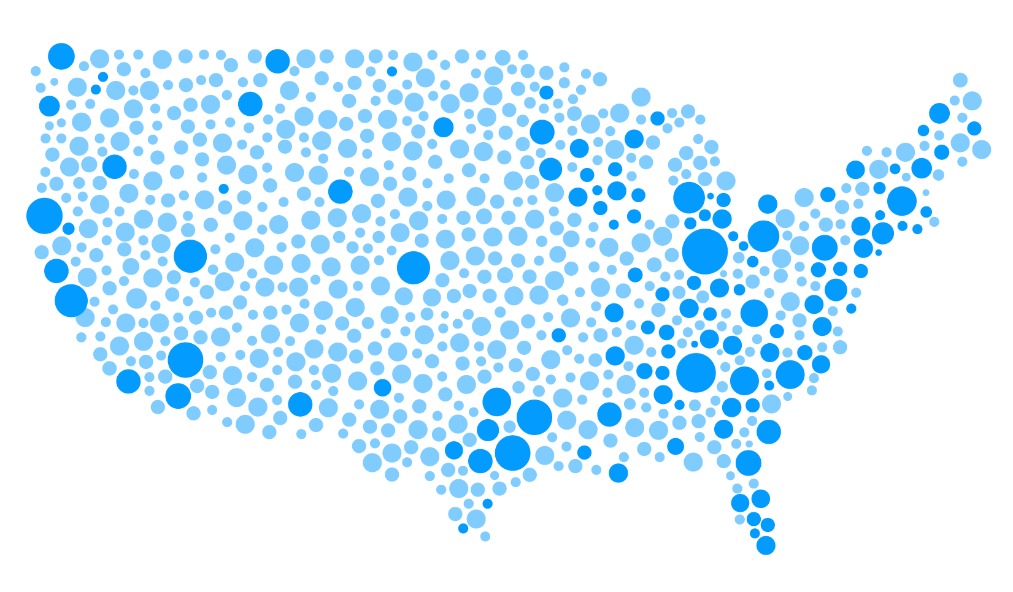

Gannett is a leading local-to-national media & marketing solutions company, and the largest local media company in America, with 100+ newsrooms spanning 34 states.
Who we are.
2,000+
100+
124M+
1.1B
500+
JOURNALISTS
NEWSROOMS
UNIQUE
MONTHLY
USERS
TOTAL PAGES PER MONTH
DIGITAL
PRODUCTS

Slide 4
Agenda
Product and user flow – Lucy
Architecture and technical details – Binita
Trivia
Q&A

Slide 5
Presto User Experience
Journalists need a tool that makes it easy to:
Create, discover and publish content
Build robust stories, enhanced by multi-media content
Collaborate within the newsroom and across the network

Slide 6
Our Goal
Presto enables newsrooms to focus on content creation without getting bogged down in content management.

Slide 7

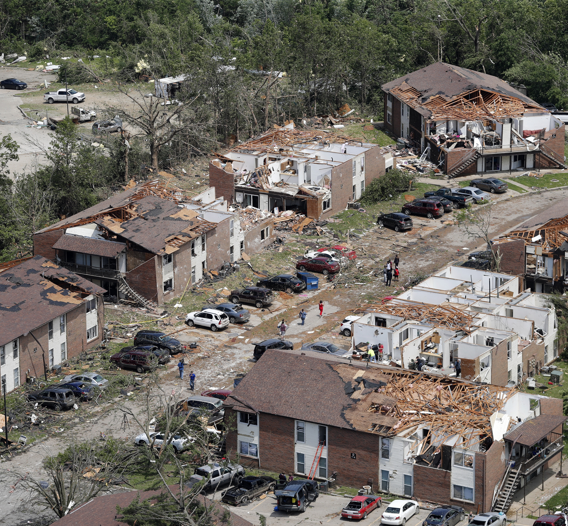
Newsroom use cases
Breaking News
Missouri Tornados – May 2019
Long Term Investigations
Deadly Deliveries – March 2019
Beat Reporting

Slide 8

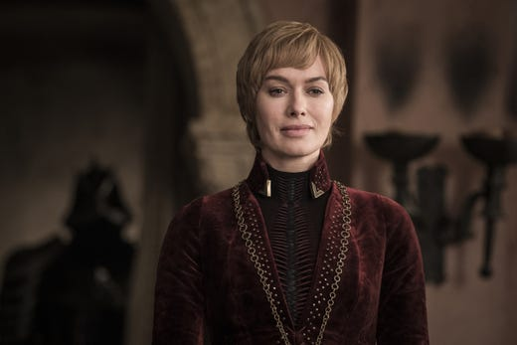
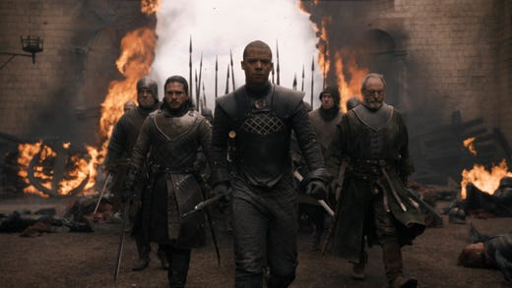
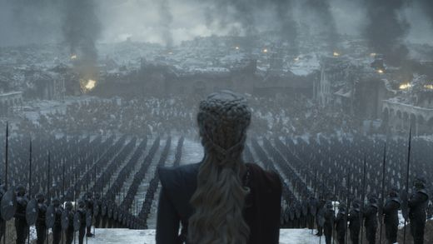
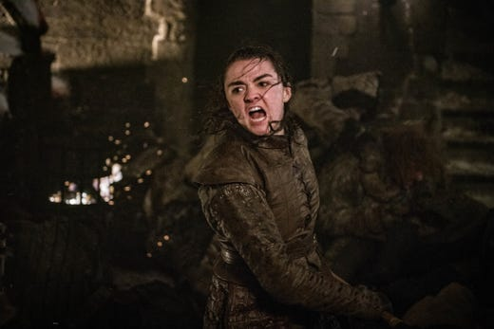

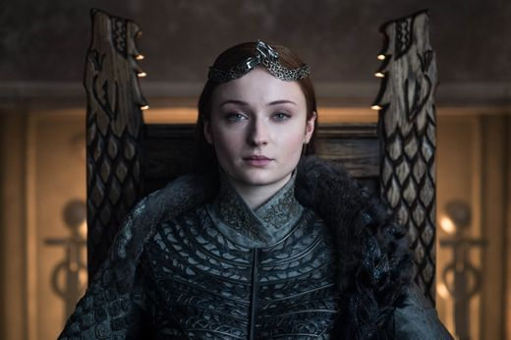

Beat reporting use case

Slide 9
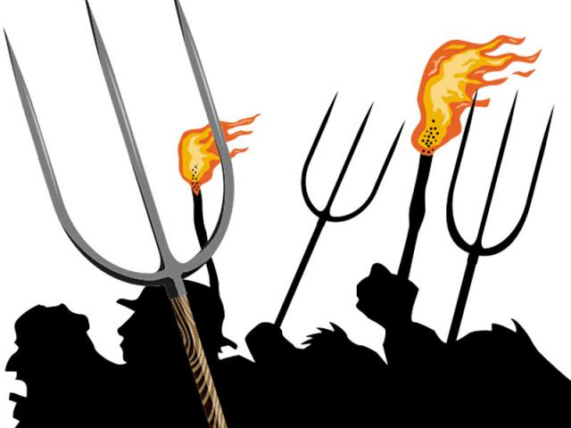
Beat reporting use case

Slide 10
Presto Demo
See this link https://drive.google.com/file/d/1hPwWRp_5C-b2IoDWLkUHZHF42YzKagSg/view?usp=sharing

Slide 11
Presto Architecture Overview
Event-driven microservices
Collection of loosely coupled services that communicate using events
CQRS (Command Query Responsibility Segregation)
Separate models for reading and writing information
Event sourcing
Changes to application state are stored as a sequence of events
Domain Driven Design
Divides large models into bounded contexts and defines a ubiquitous language

Slide 12
Software stack
AngularJS
NodeJS
Couchbase
Solr
Google Pub Sub
RabbitMQ

Slide 13
Event driven microservices
Collection of loosely coupled services that communicate using events
Scaling
Isolated Deployments

Slide 14
Event driven microservices
Google Vision API
Image handler
Video handler
Transcoding API
Video API
Presto CMS
Queuing
Create a story
Index handler
Snapshot handler
Publish handler
Add an image
Add a video
Publish the story
Indexer
Data Store
Presentation ecosystem

Slide 15
CQRS Command Query Responsibility Segregation
Separate models for reading and writing information
Scaling
Availability

Slide 16


Command Query Responsibility Segregation
Datastore
Presto CMS
Command model
Push button “Create Story”
Send command “Create Story”
Write event “Story Created”
Push button “Publish Story”
Send command “Publish Story”
Write event “Story Published”
Query model
View Story
Query Read Story
Read
Synced via event buses
Query model
Read datastore
View Story
Web
Query Read Story
Read
View Story
Mobile
Query Read Story

Slide 17
Event Sourcing
Changes to application state are stored as a sequence of events
History
Time travel
Rapid evolution

Slide 18
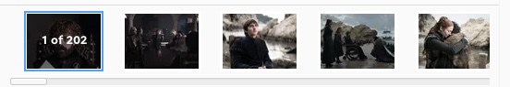
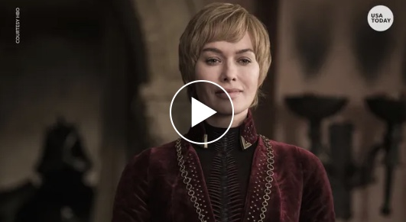
Event Sourcing
Image Gallery Added
applyTo
Story Headline Set
applyTo
Story Body Set
applyTo
Story Created
applyTo
Story
(empty)
Story
id: GOTSeason8
createdBy: Jayme Deerwester
createdDate: 16th May 2019
Story
id: GOTSeason8
createdBy: Jayme Deerwester
createdDate: 16th May 2019
Headline: More than 300,000 'Game of Thrones’ fans sign petition calling for a redo of Season 8
Story
id: GOTSeason8
createdBy: Jayme Deerwester
createdDate: 16th May 2019
Headline: More than 300,000 'Game of Thrones’ fans sign petition calling for a redo of Season 8
Body: As of Friday, more than 300,000 fans had signed the petition…
Story
id: GOTSeason8
createdBy: Jayme Deerwester
createdDate: 16th May 2019
Headline: More than 300,000 'Game of Thrones’ fans sign petition calling for a redo of Season 8
Body: As of Friday, more than 300,000 fans had signed the petition…
Story
id: GOTSeason8
createdBy: Jayme Deerwester
createdDate: 16th May 2019
Headline: More than 300,000 'Game of Thrones’ fans sign petition calling for a redo of Season 8
Body: As of Friday, more than 300,000 fans had signed the petition…
Story
id: GOTSeason8
createdBy: Jayme Deerwester
createdDate: 16th May 2019
Headline: More than 300,000 'Game of Thrones’ fans sign petition calling for a redo of Season 8
Body: As of Friday, more than 300,000 fans had signed the petition…
Published By: Jayme Deerwester Publish Date: 6th May 2019
applyTo
Video Added
applyTo
Story Published

Slide 19
Domain Driven Design
Divides large models into bounded context
Ubiquitous language
Define boundaries

Slide 20
Domain Driven Design - Context Map
Authoring domain
Bounded context
Image gallery subdomain
External domain
Taxonomy system
Story subdomain
Video subdomain
Bounded context

Slide 21
Domain Driven Design
Story Aggregate root
constructor() {
this.domainmodel = new StoryDomainModel
}
create(id) {}
setHeadline(headline) {}
setBody(body) {}
addAssociatedAsset (asset) {}
Ubiquitous language
Domain entity = Aggregate Root
Domain model
Behavior drives State
Story domain model
constructor() { this.id = null; this.createdBy = null; this.createdByUser = null; this.headline = null; this.body = null; this.associatdAssets = []; } events.created(event) {
this.id = event.data.id;
this.createdBy = event.data.createdBy;
this.createdByUser = event.data.createdByUser
}
events.headlineSet(event) {
this.headline = event.data.headline;
}
events.bodySet(event) {
this.body = event.data.body;
}
events.associatedAssetAdded (event) {
this.associatedAssets.add(event.data.associatedAsset)

Slide 22
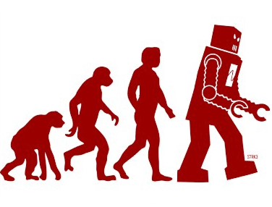
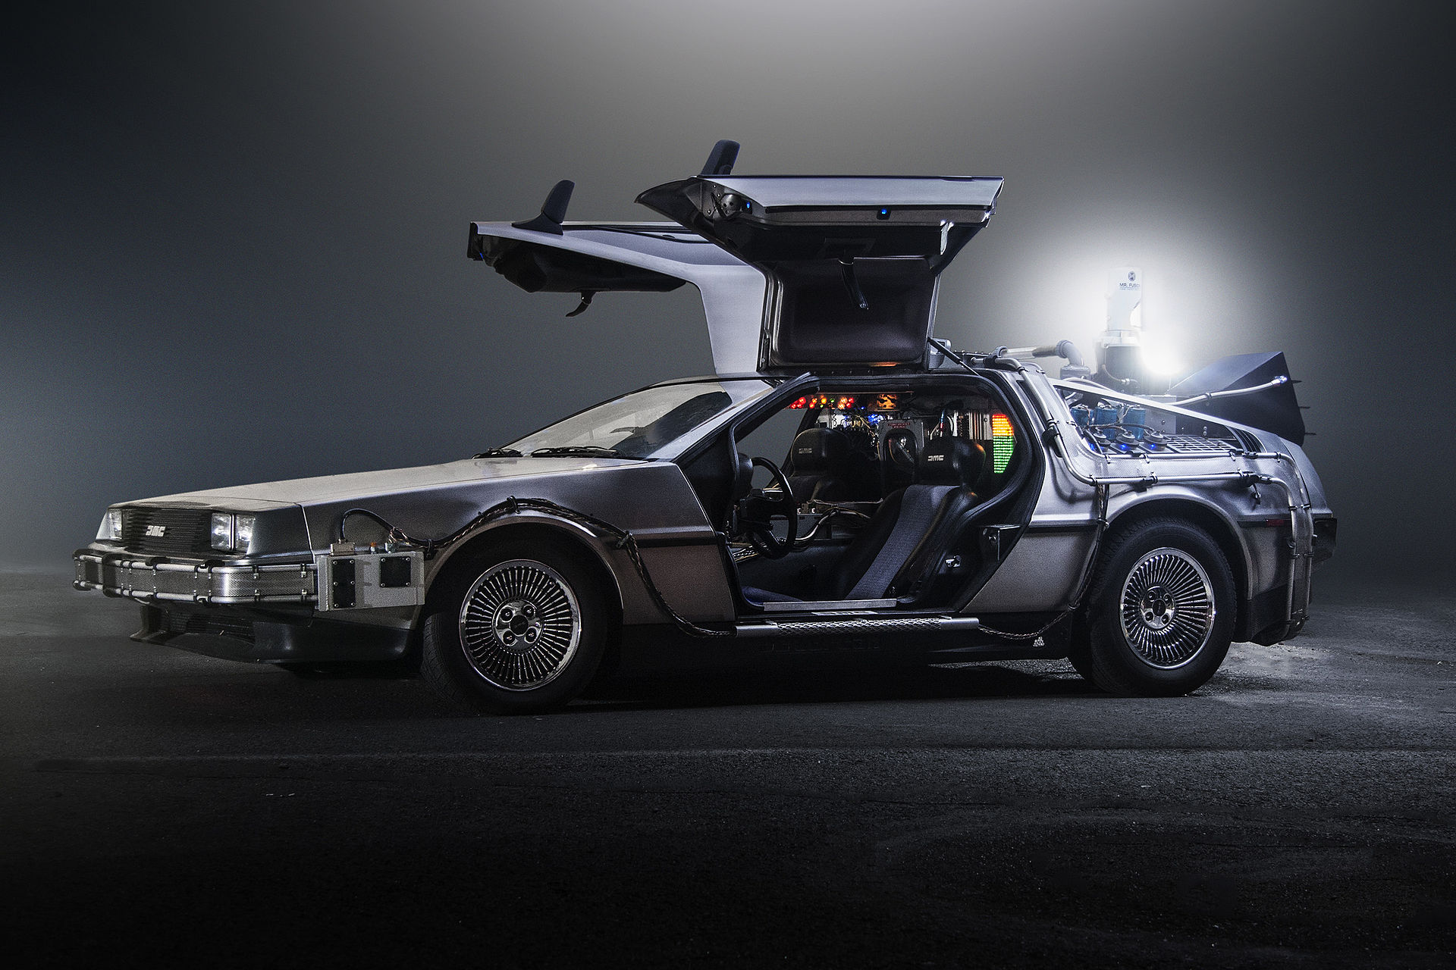


Advantages
Rapid evolution
Time travel
Scalability
Availability
Isolated Deployments

Slide 23
Challenges
HHC Theorem
CAP Theorem
Performance
Snapshots
Projections aka read models
Eventual consistency
Paradigm shift
Debugging
Happy kids
Consistency
CA
CP
HH
HC
X
X
Availability
Partition tolerance
Happy parents
AP
Clean house
HC

Slide 24
References
Greg Young- CQRS and Event Sourcing – Code on the Beach 2014 https://www.youtube.com/watch?v=JHGkaShoyNs
CQRS Documents – Greg Young
Martin Fowler https://martinfowler.com/
Domain-Driven Design: Tackling Complexity in the Heart of Software by Eric Evans
Implementing Domain-Driven Design by Vaughn Vernon

Slide 25
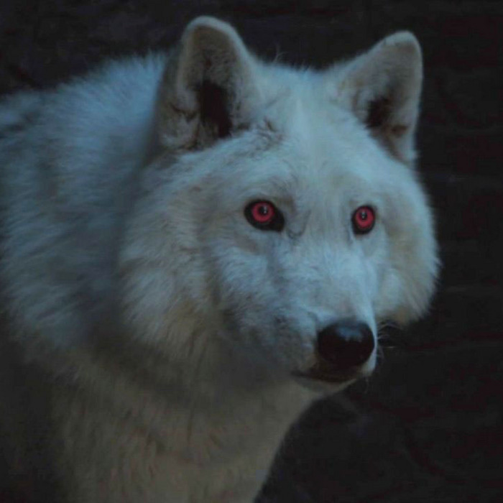

Trivia Questions
What is the name of Jon Snow’s direwolf?
What does CQRS stand for?
How many Pulitzer prizes has Gannett won in the last year?
Which architectural pattern helps us with time travel?
Command Query Responsibility
Segregation
Event Sourcing!
Ghost

Slide 26
Q & A

Slide 27
CONTACT
Lucy Collins
https://www.linkedin.com/in/lucy-m-collins/
lcollins@gannett.com
Binita Mehta https://www.linkedin.com/in/binitamehta/
binita_mehta
bmehta@gannett.com
THANK YOU

